Slide 1

HOME AUTOMATION
INDUSTRIAL INSTRUMENTATION LAB
3RD YEAR PROJECT WORK
ELECTRONICS AND INSTRUMENTATION ENGINEERING
National Institute of Technology Agartala
Team Members: Ankit Kumar Singh, Muskan Gupta, Golu Kumar, Ashish Kumar, Abantika Deb
Guided by: Dr. Rupam Gupta Roy
Technical Assistant: Kailash Pratim Phukan, Suraj Das

Slide 2



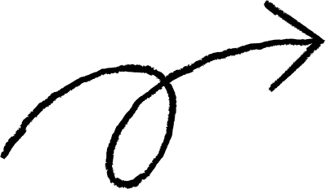







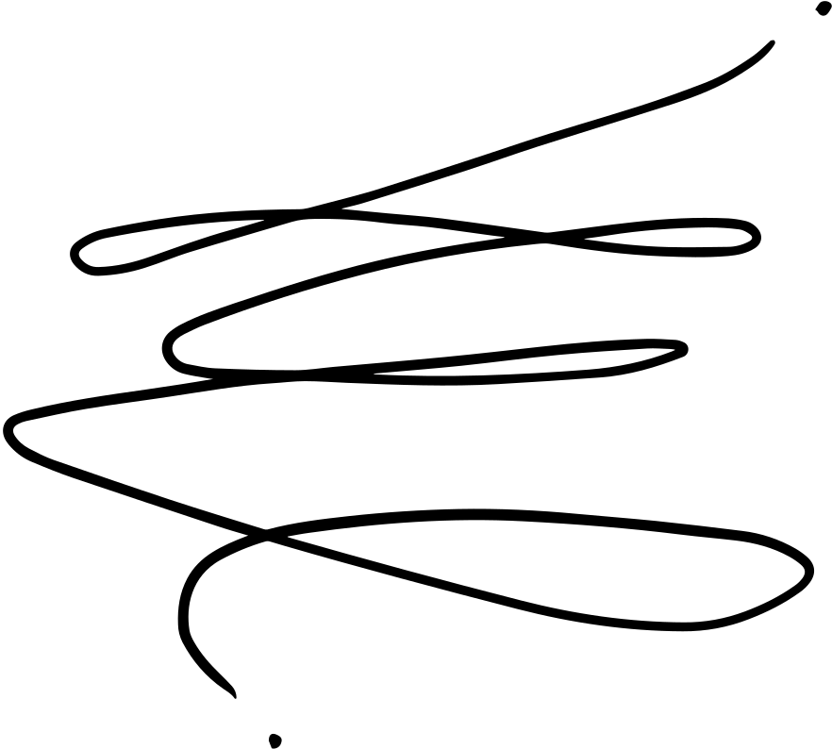

AGENDA
Introduction
Programming
Circuit Diagram
Components
working

Slide 3



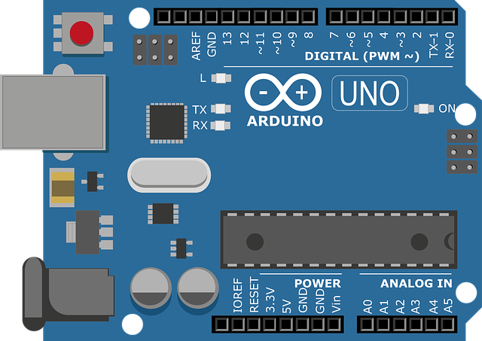

INTRODUCTION
The Smartphone-Controlled Home Automation Project is a cutting-edge integration of technology that empowers users to conveniently control the intensity of LED lights and the speed of a fan from their smartphones.
The system employs an Arduino Uno microcontroller, an HC-05 Bluetooth module, an L298N motor driver, and a custom mobile application developed using MIT
App Inventor.

Slide 4




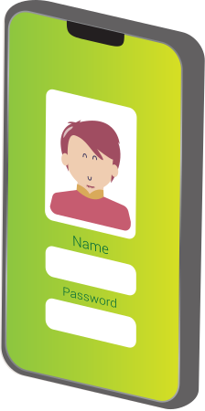
COMPONENTS
Ardunio UNO R3
HC-05 Bluetooth Module
L298N Motor Driver
LED
DC Motor(3V)
Android Application

Slide 5
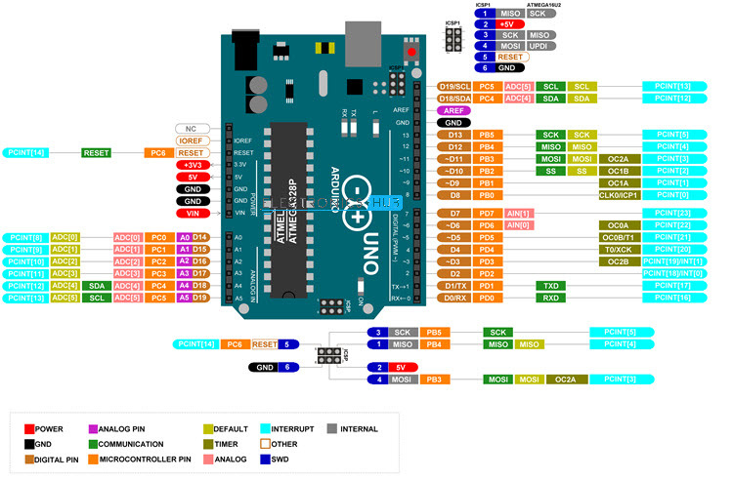
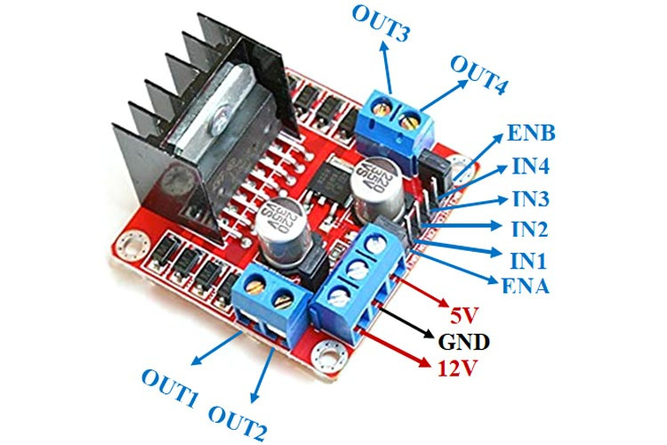
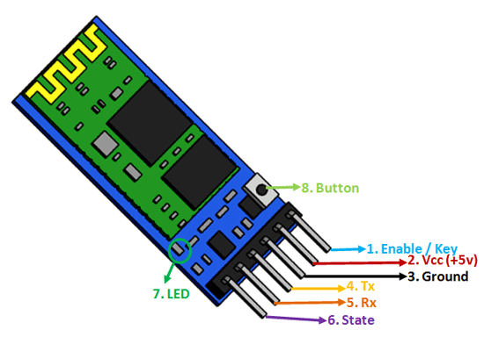
Arduino UNO
L298N Motor Driver
HC-05 Bluetooth Module

Slide 6
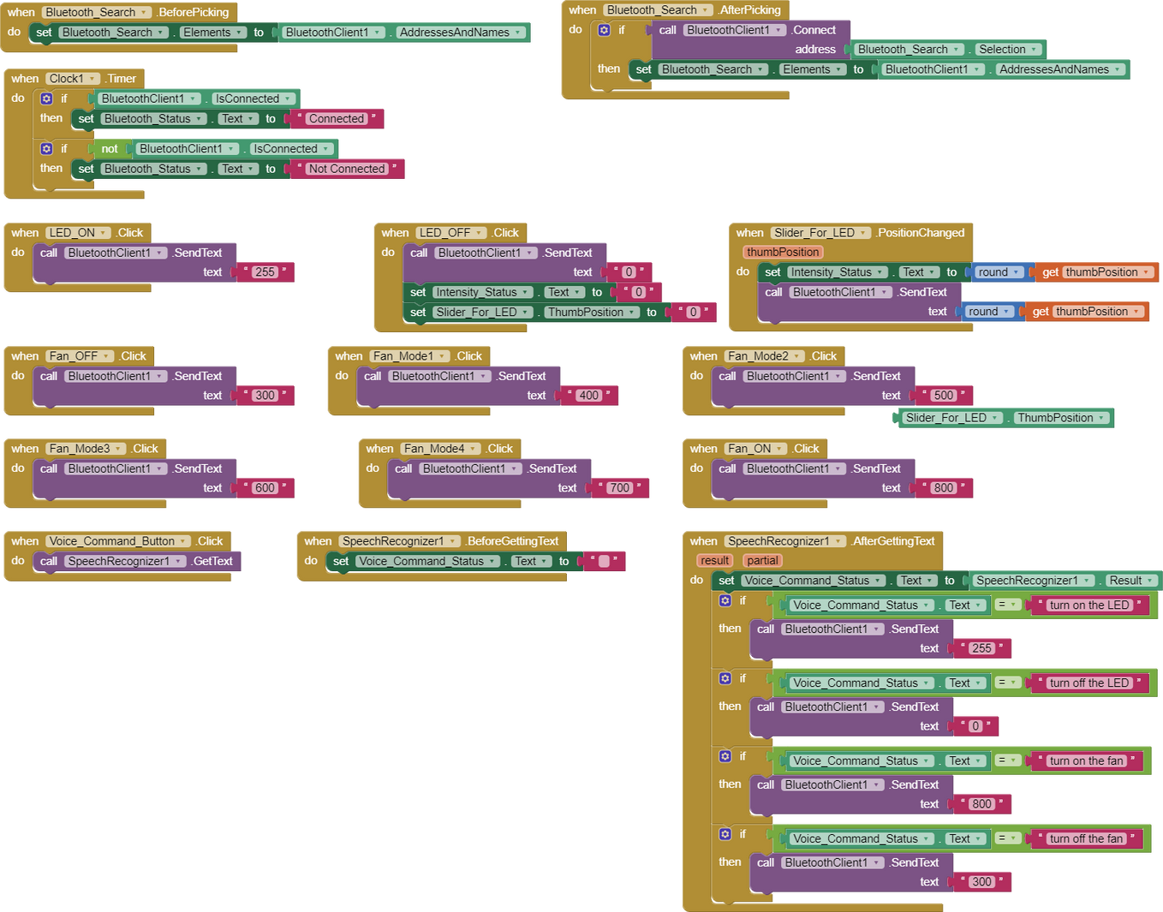
Backend Code of Application

Slide 7



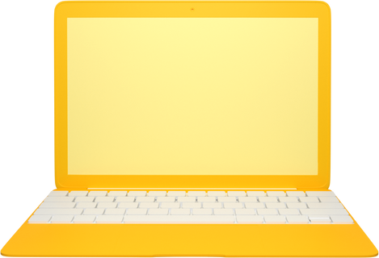

Slide 8


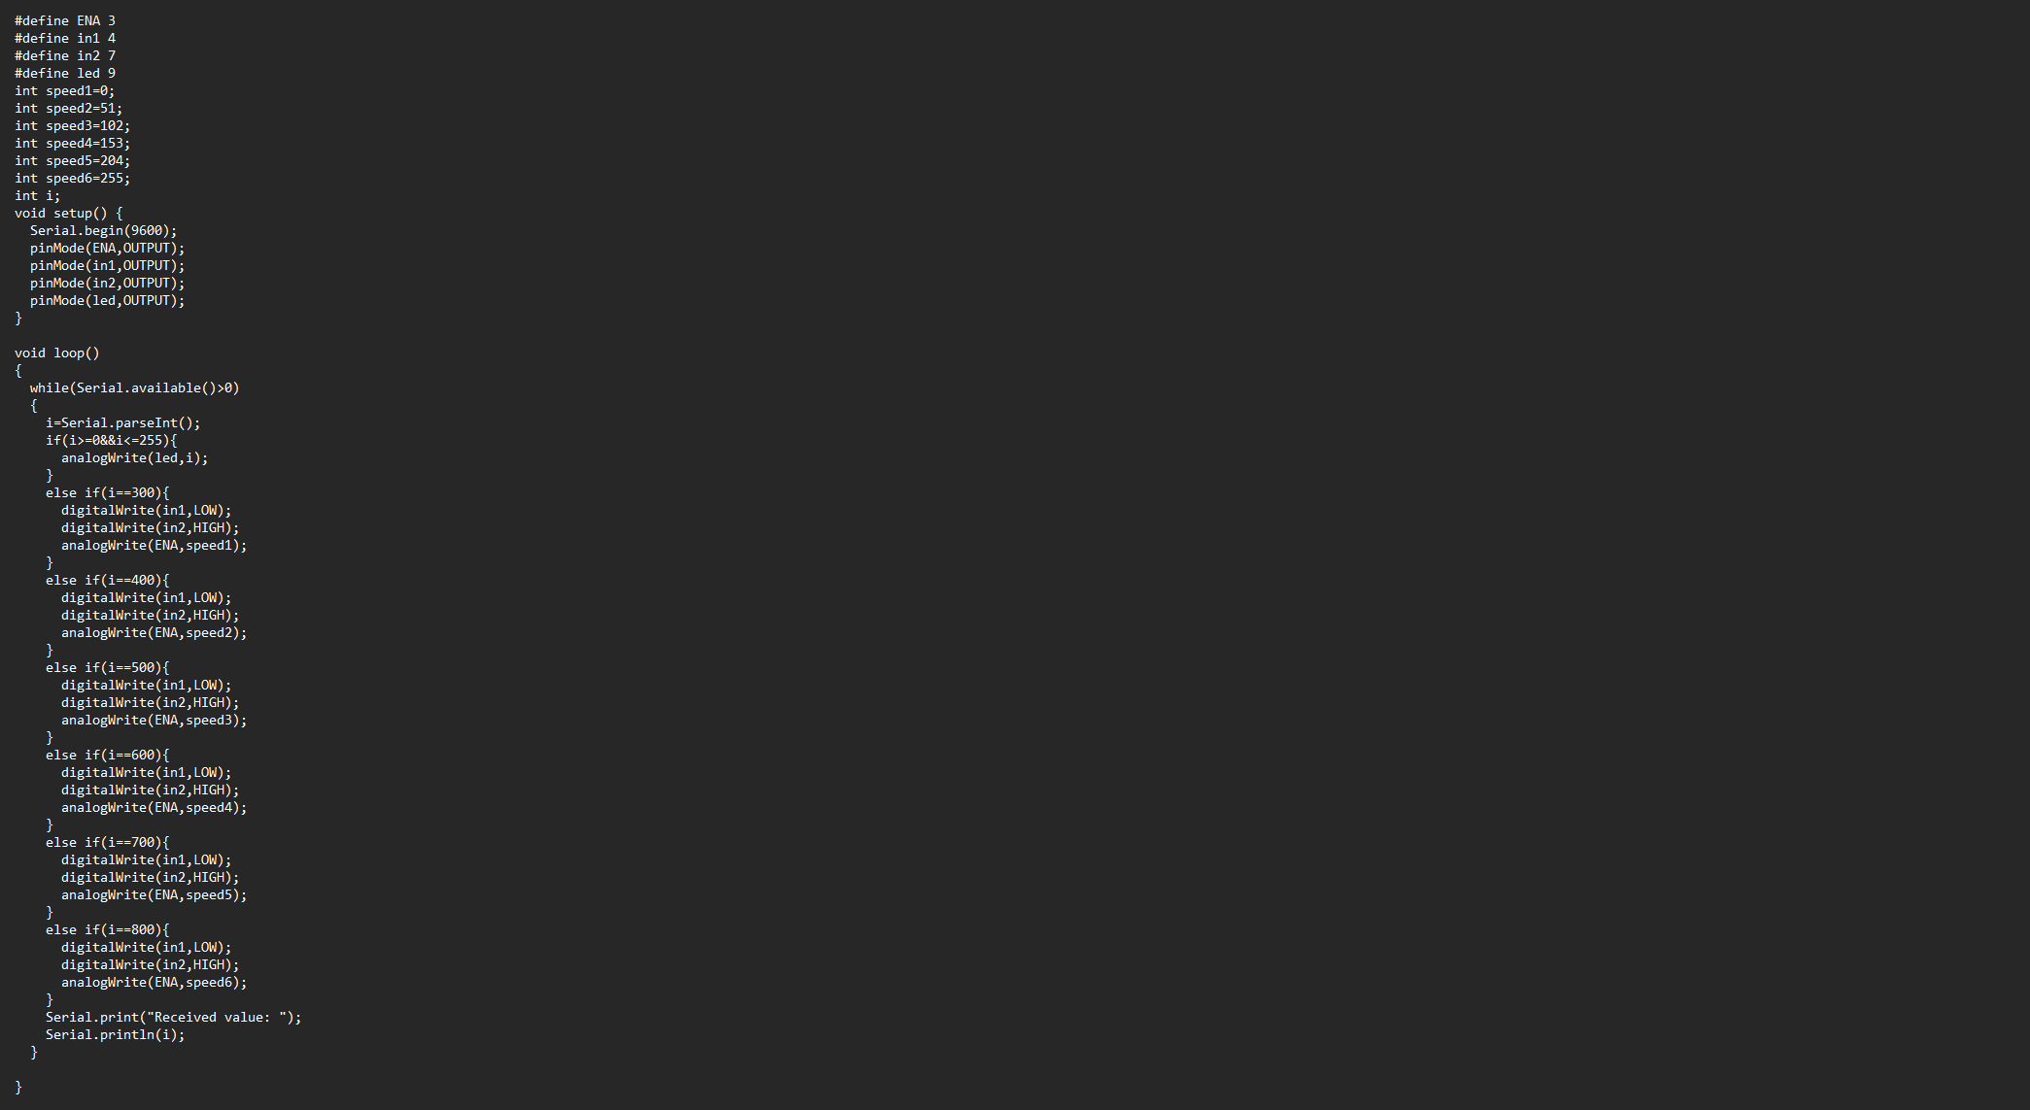
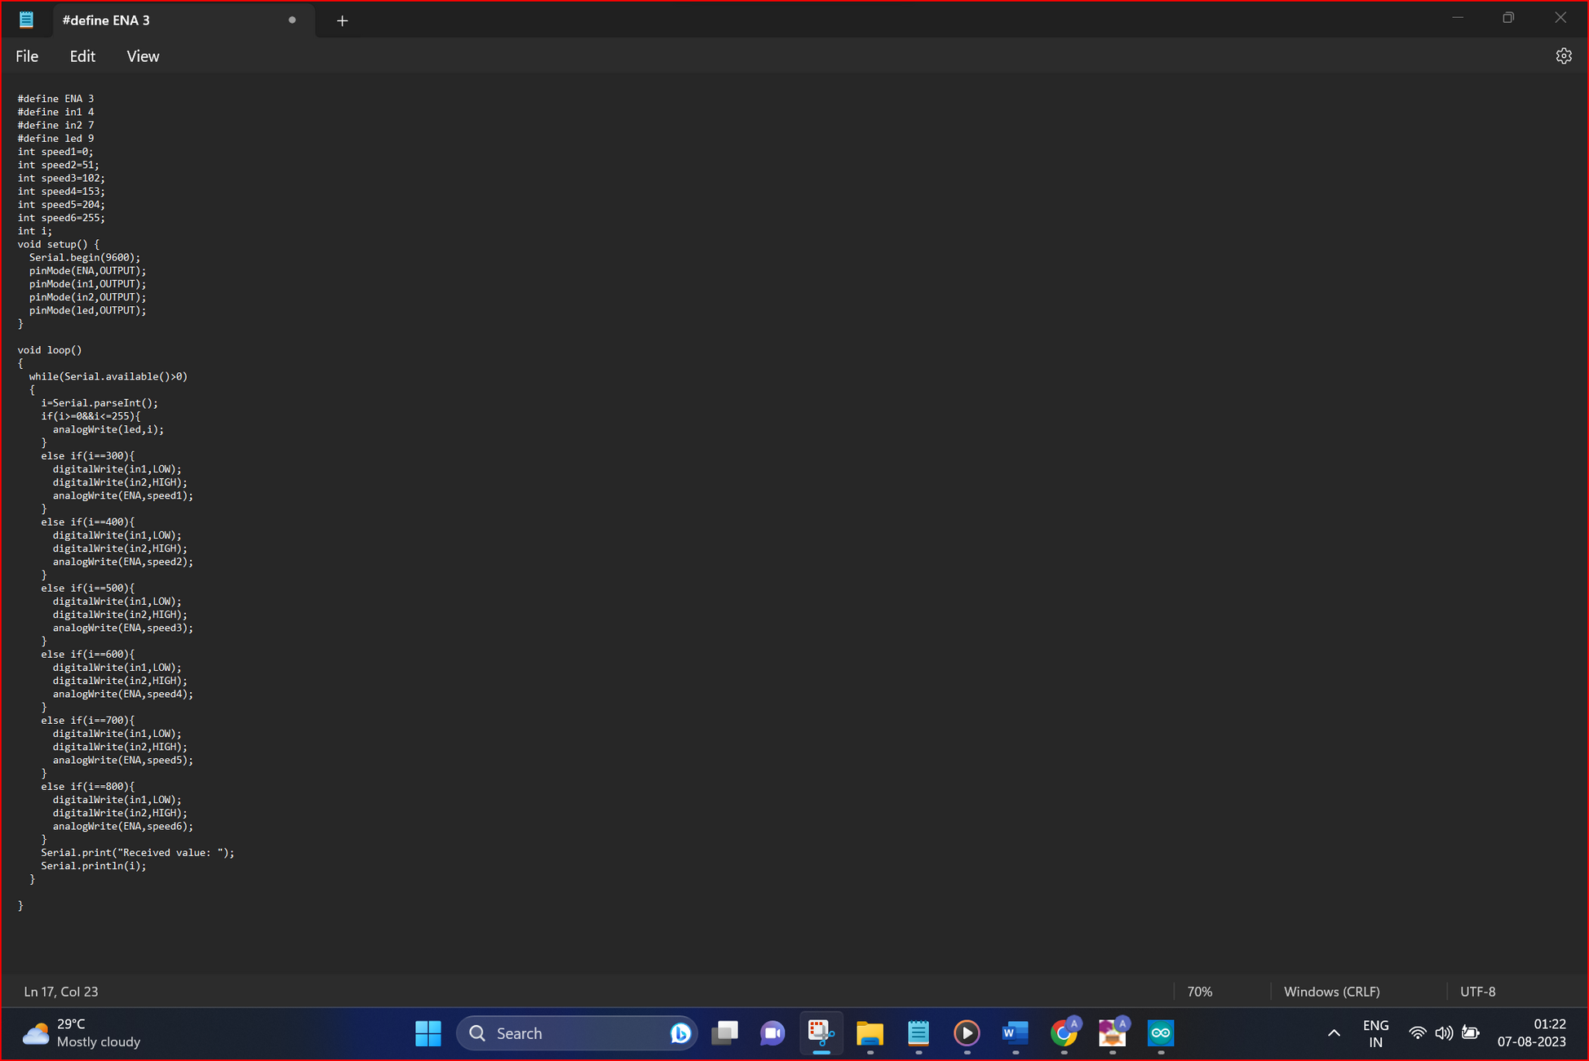

Slide 9




CIRCUIT DIAGRAM

Slide 10
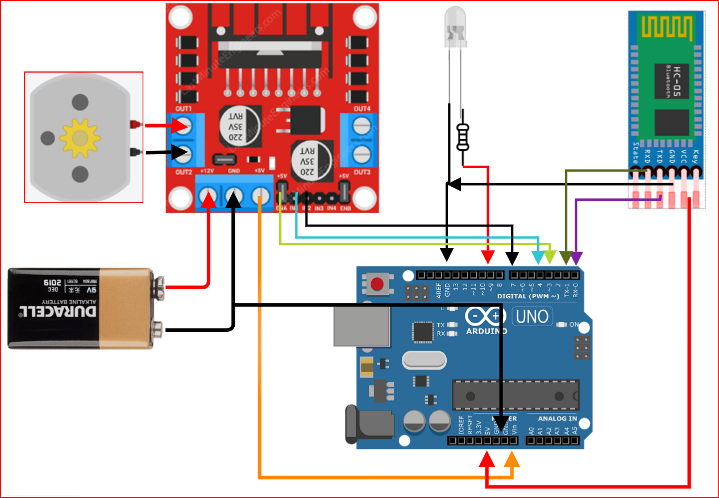

Slide 11
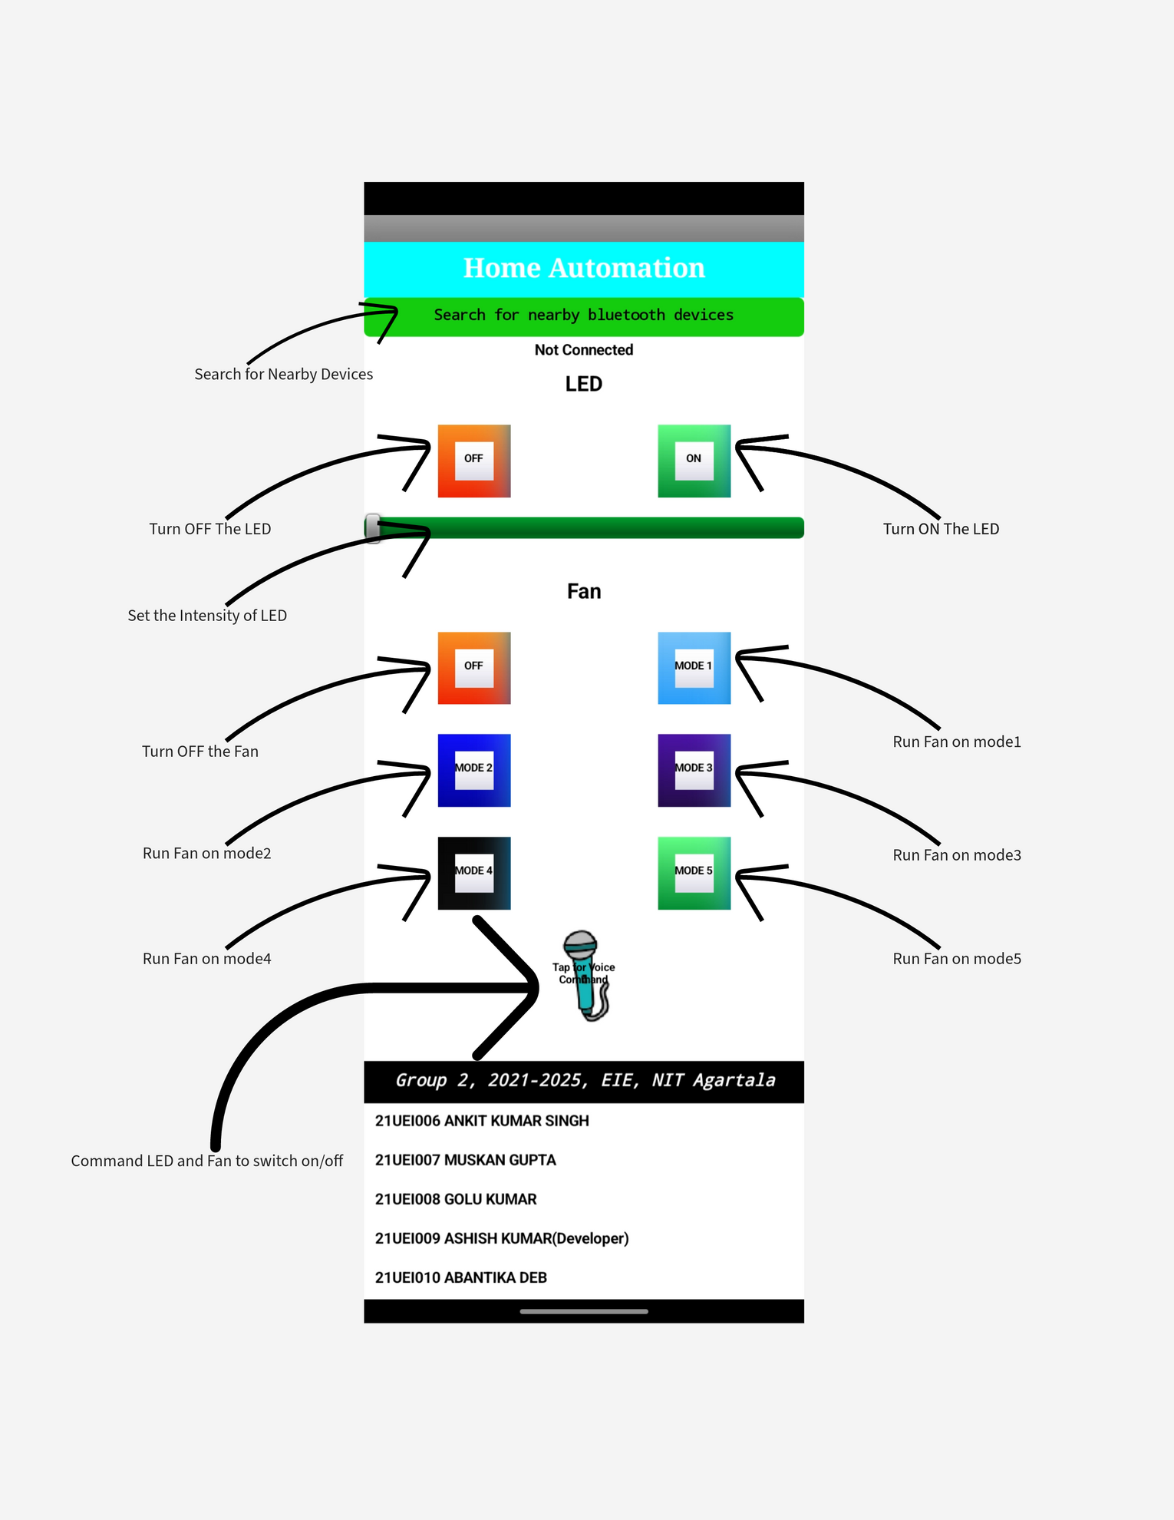

Application
Interface

Slide 12
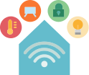
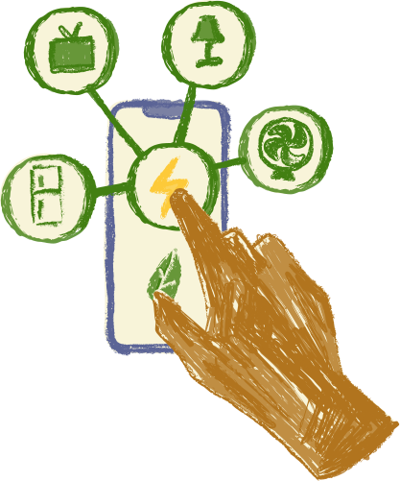
Benefits
• Convenience: Users can manage their home environment remotely, enhancing comfort and energy efficiency.
• Customization: The system allows personalized control over lighting and ventilation, contributing to a tailored living experience.
• Technological Learning: Implementing this project offers valuable insights into Arduino programming, Bluetooth communication, and mobile application development.
• Cost-Efficiency: The project provides an economical solution for home automation compared to commercial alternatives.
• Integration Potential: This project can serve as a foundation for expanding the home automation network to include additional devices and functionalities.

Slide 13


Conclusion
The Smartphone-Controlled Home Automation System utilizing Arduino Uno, HC-05, and MIT App Inventor represents a leap forward in smart living. By integrating these technologies, users gain the power to control their home environment effortlessly and efficiently, all from the palm of their hand.

Slide 14







